Slide 1
COVID-19 Communications: Promoting Prevention Measures & Vaccine Confidence
www.nfid.org/coronavirus
Notes:
The National Foundation for Infectious Diseases (NFID) convened a multidisciplinary expert roundtable in January 2021 to share research, insights, and best practices for improving and harmonizing communication to the public about the evolving COVID-19 pandemic and the importance of following evidence-based public health prevention measures.

Slide 2




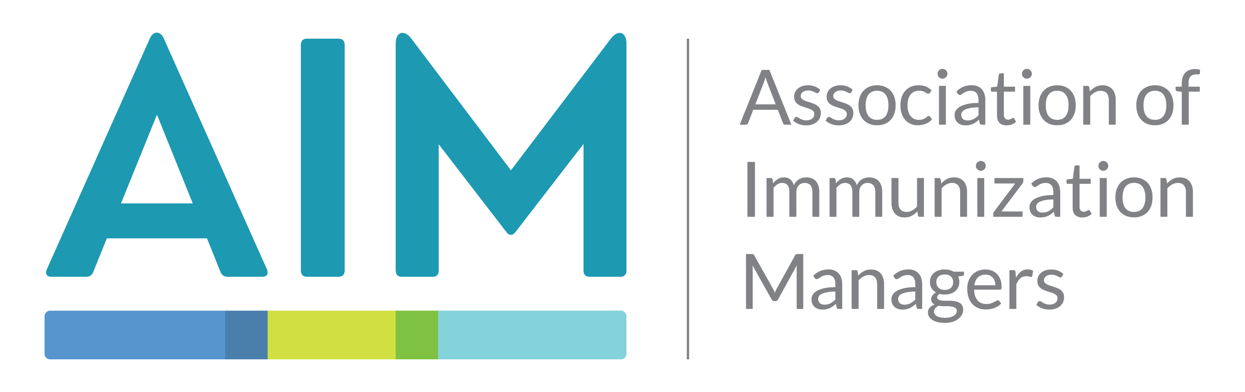
















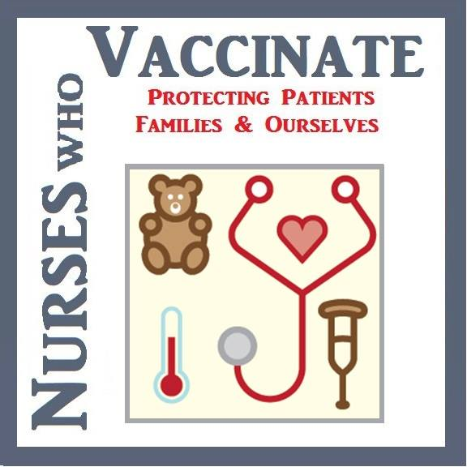






























Partner Organizations
Notes:
More than 50 leading multisector organizations participated in the roundtable to discuss behaviors and beliefs interfering with adherence to COVID-19 prevention measures.
Out of that discussion emerged a new communications framework to help address key obstacles—which was published in a new report, COVID-19 Communications: Promoting Prevention Measures and Vaccine Confidence.

Slide 3
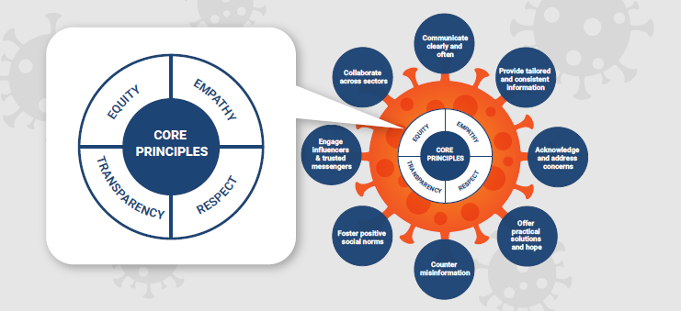
4 Core Principles: Respect, Empathy, Transparency, & Equity
Notes:
The only way we can address the challenges of a pandemic is through proactive communications that address concerns, meet the needs of specific target audiences, and offer practical solutions to help people follow public health guidance.
Good communications must be built on these core principles (Respect, Empathy, Transparency, and Equity).

Slide 4
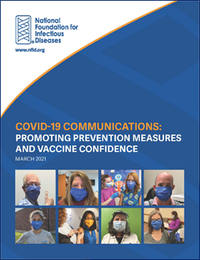
COVID-19 Communication Strategies
Communicate clearly and often
Use facts whenever possible, acknowledging that information continues to evolve
Provide consistent, tailored information
While messages need to be consistent, the way to say it may change based on audience
Acknowledge and address concerns
Questions and concerns are expected and should be addressed directly
Offer practical solutions and hope
Motivate by framing prevention measures and vaccination as best tools to help stop the spread
Counter misinformation
Proactively share accurate information
Foster positive social norms
Reinforce importance of prevention measures by making desired behaviors visible and celebrated
Engage influencers and trusted messengers
Work with trusted leaders and organizations with influence and credibility to boost confidence
Collaborate across sectors
Ensure consistent communication, policy, and action to reduce confusion

Slide 5
Evolving COVID-19 Knowledge
New, emerging variants
Duration of immunity
Potential for transmission post-vaccination
Need for annual vaccinations/ booster doses
How long masks will be necessary
Impact of vaccination on daily activities
Notes:
By their nature, pandemics are rapidly evolving situations that require adjustments to guidance and recommendations as new scientific discoveries are made.
This can leave people feeling as though they are receiving different or conflicting advice.

Slide 6
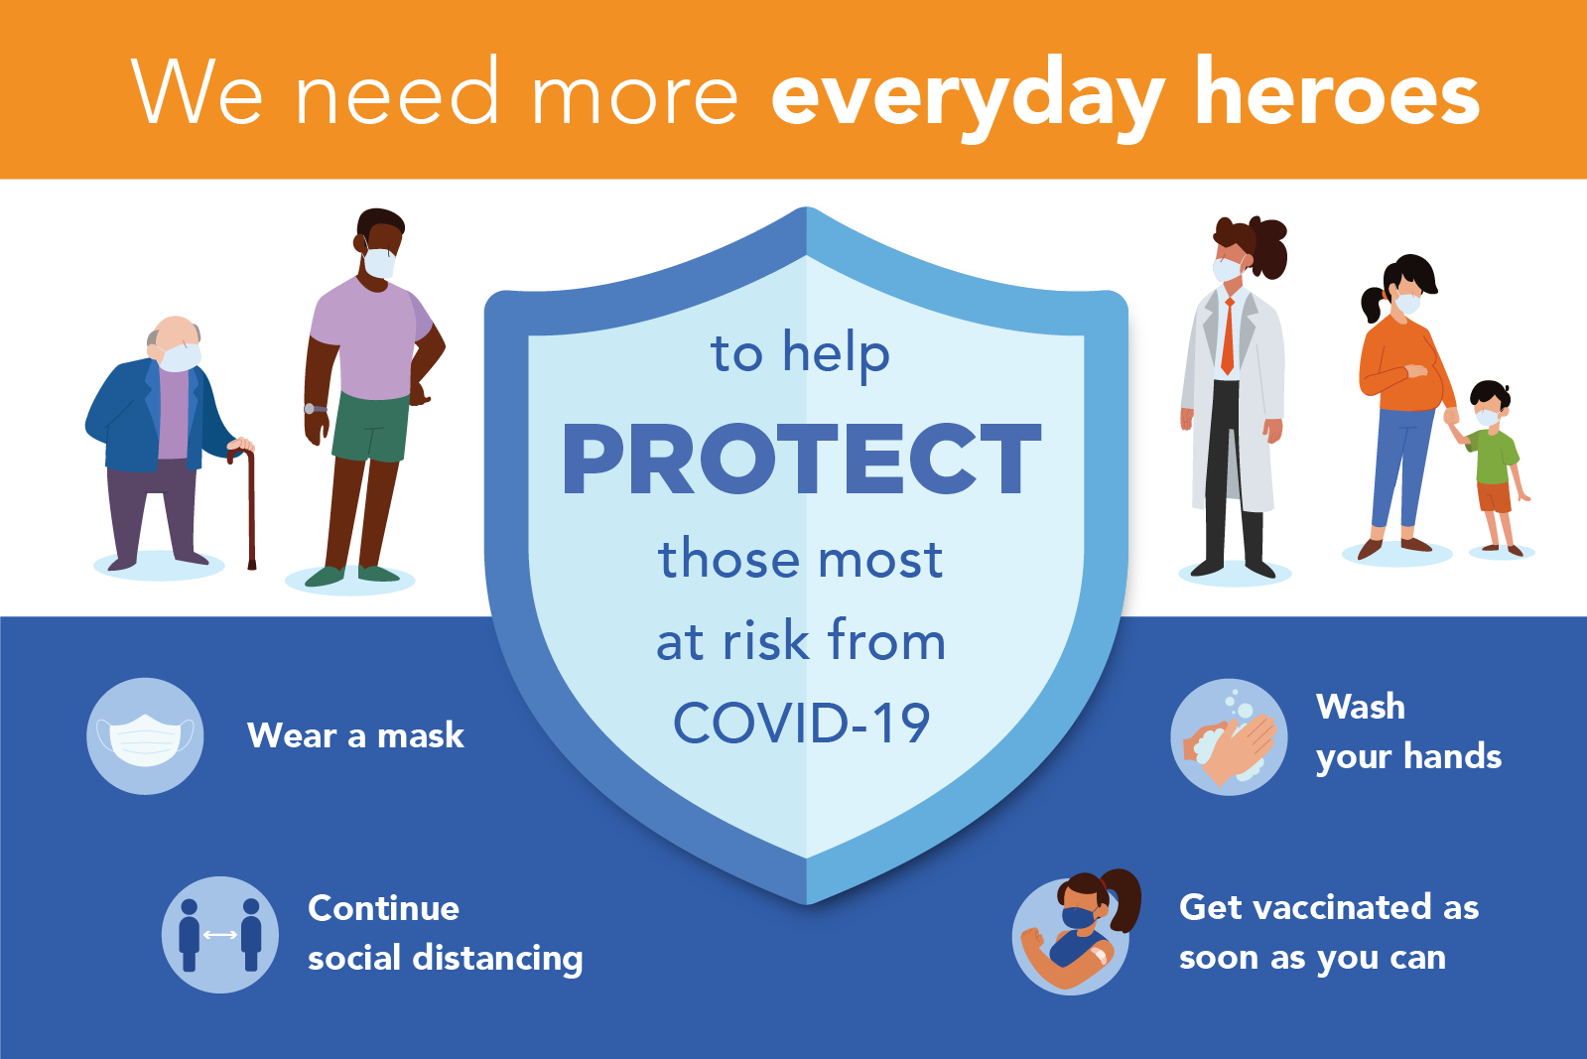
Key Messages: Together We Can Win The Fight

Slide 7
Addressing Barriers to Adherence
Individuals may not be aware of current guidelines or understand how to properly follow them
Unclear, changing guidelines cause confusion among the public and plant seeds for misinformation
Socioeconomic status may also be a significant barrier to following recommendations
Acknowledging challenges can make messaging more empathetic, credible, and effective

Slide 8
Encouraging Vaccine Acceptance
Foster vaccine confidence among the “moveable middle”
Those who identify as “wait and see” are more likely to be persuaded
Do not expect to change the mind of those who have firmly decided not to be vaccinated
Address concerns and misinformation
Acknowledge that questions and concerns are reasonable and expected
Understand the basis of the concerns
Suggest they talk with a trusted healthcare professional about specific medical concerns
Communicate transparently, but empathetically about COVID-19 vaccines
Talk about development process, technology, ingredients, side effects, and ongoing safety monitoring
Avoid lecturing or shaming, and know when to move on

Slide 9
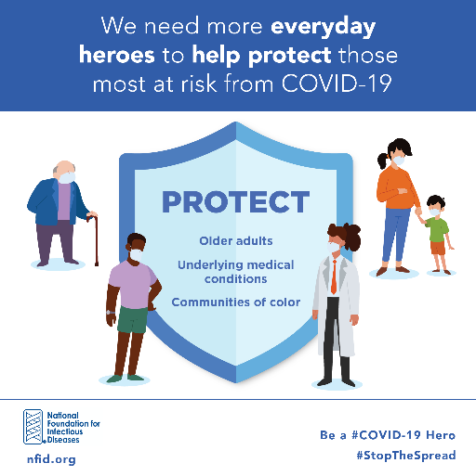
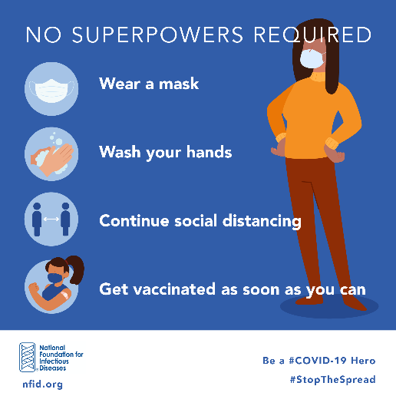
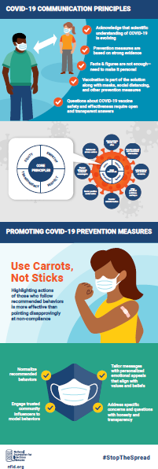
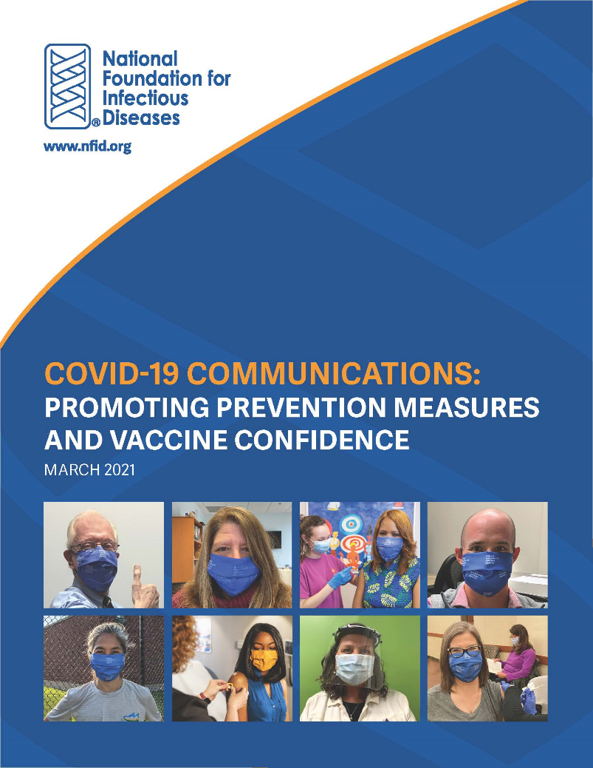
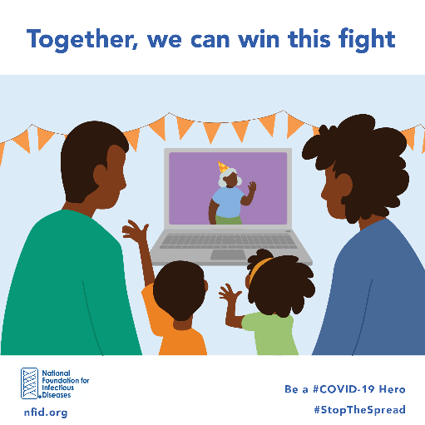

COVID-19 Communications Toolkit
www.nfid.org/covid-19-communications

